Slide 1

Chapter 16
Therapies
Photo credit: © Maridav/Shutterstock
© 2020 McGraw-Hill Education. All rights reserved. Authorized only for instructor use in the classroom. No reproduction or further distribution permitted without the prior written consent of McGraw-Hill Education
Notes:
Photo credit: © Jamie Grill/JGI/Getty Images

Slide 2
Chapter Preview
Psychotherapy
Biological Therapies
Sociocultural Approaches
Effectiveness
Health and Wellness
Notes:
Chapter 16

Slide 3
Psychotherapy
A non-medical process that helps individuals with psychological disorders recognize and overcome their problems
Psychotherapy versus Biomedical therapy (Psychiatrists)
Insight versus Symptoms & Skill Development
Directive versus Nondirective
Notes:
Note: While cognitive therapists bill theirs as a “skill” approach rather than an “insight” approach, the skills such therapies promote include skill at insight (into one’s irrational thought habits).

Slide 4
Effectiveness of Psychotherapy
(1 of 2)
All therapies are “winners”.
Factors in Success of Psychotherapy
  therapeutic alliance (monitored)
  therapist expertise and personality
  client active engagement

Slide 5
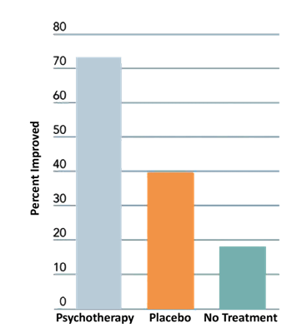
Effectiveness of Psychotherapy
(2 of 2)
Access the text alternative for slide images.

Slide 6
Psychodynamic Therapies
(1 of 3)
Empirically supported treatment (tailored to particular disorder)
Evidence-based practice: Combines
  Best available research
  Therapist’s clinical judgment
  Client characteristics/preferences

Slide 7
Psychodynamic Therapies
(2 of 3)
Emphasis of this Approach
  early childhood experiences
  unconscious conflicts
  therapeutic interpretation
Goals of Therapy
  recognize maladaptive coping strategies
  identify sources of unconscious conflicts

Slide 8
Psychodynamic Therapies
(3 of 3)
Freudian Psychoanalysis
  free association
  dream analysis (manifest versus latent content)
  transference
Contemporary Psychodynamic Therapies
  Less focus on sex, more focus on the present

Slide 9
Humanistic Therapies
Emphasis of this Approach
  conscious thoughts
  self healing
  self fulfillment
Goals of Therapy
  self understanding
  personal growth

Slide 10
Roger’s Client-Centered Therapy
Nondirective Self-Exploration
Warm, Supportive Atmosphere
  active listening and reflective speech
  unconditional positive regard
  empathy and genuineness
Notes:
Suggestion: Ask students, “If you had a mental illness and were seeking therapy, which would you prefer, psychoanalysis or client-centered therapy, and why?”

Slide 11

Behavior Therapies (1 of 4)
Photo credit: Somos RF/Getty Images

Slide 12
Behavior Therapies (2 of 4)
Emphasis of this Approach
  overt behavior change rather than insights into self or into underlying causes
Goals of Therapy
  reduce or eliminate maladaptive behaviors
Classical and Operant Conditioning

Slide 13
Behavior Therapies (3 of 4)
Classical Conditioning Techniques Treating Phobias
Systematic Desensitization
  develop hierarchy of fearful scenes
  learn relaxation techniques
  apply relaxation while imagining fearful scenes

Slide 14
Behavior Therapies (4 of 4)
Operant Conditioning Techniques…
unlearning of maladaptive behavior (for example, OCD) through altered consequences.
Applied Behavior Analysis
  positive reinforcement of adaptive behaviors
  extinguish maladaptive behaviors
  does not depend on gaining insight

Slide 15
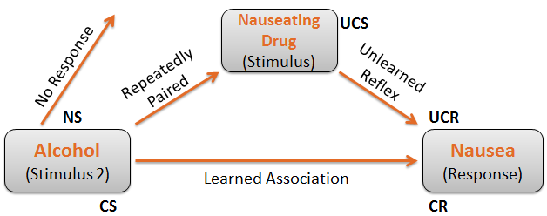
Aversive Conditioning (1 of 2)
Access the text alternative for slide images.
Notes:
Note: This example is illustrative only. Contrary to the implication of this diagram, Antabuse does not cause nausea when taken by itself: It only causes nausea if alcohol is also consumed. Moreover, in practice, Antabuse is not used so much to create a lasting distaste for alcohol as to prevent sneaking beers when in detox.

Slide 16
Aversive Conditioning (2 of 2)
Neutral Stimulus
Conditioned Stimulus
Unconditioned Stimulus
Acquisition/Learning
Innate S-R Association
Unconditioned Response
Conditioned Response

Slide 17
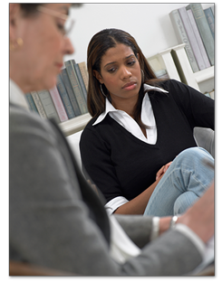
Cognitive Therapies (1 of 3)

Slide 18
Cognitive Therapies (2 of 3)
Emphasis of this Approach
  thoughts (cognitions) are the primary source of psychological problems
  how we think controls how we feel
  focus on overt problems (unlike Freud)
  structured analysis and specific guidance (unlike Rogers)
Goals of Therapy
  cognitive restructuring

Slide 19
Cognitive Therapies (3 of 3)
Challenge Idiosyncratic meanings
Question the evidence
Reattribution (redistributing responsibility)
Examine options & alternatives
Decatastrophize
Fantasize consequences
Examine advantages & disadvantages
Turn adversity to advantage
Thought stopping
Helpful distractions

Slide 20
Cognitive-Behavior Therapy
(1 of 2)
Albert Bandura and Self Efficacy
Cognitive-Behavior Therapy
  self-defeating thoughts
  incorporates behavior therapy
  self-instructional methods

Slide 21
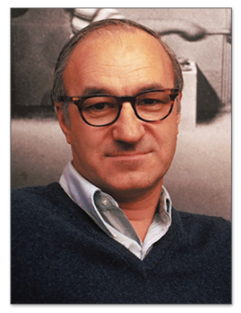
Cognitive-Behavior Therapy
(2 of 2)
Photo credit: © Jon Brenneis/Life Magazine/Time & Life Pictures/Getty Images

Slide 22
Therapy Integrations
Techniques from different therapies are combined for the benefit of the client (for example, dialectical behavior therapy).

Slide 23
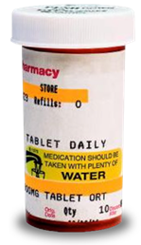
Biological Therapies (1 of 2)
Photo credit: © Comstock/Alamy

Slide 24
Biological Therapies (2 of 2)
  Reduce/eliminate symptoms by altering body functioning
Common Forms of Biological Therapy
  drug therapy
  electroconvulsive therapy (ECT)
  psychosurgery

Slide 25
Antianxiety Drugs
Antianxiety Drugs
  Benzodiazepines (Xanax, Valium, Librium)
    addictive
    side effects (mental slowing)
  Buspirone
    short term effectiveness
    prone to tolerance

Slide 26
Antidepressant Drugs
Antidepressant Drugs
  Tricyclics (Elavil)
  Tetracyclics (Avanza)
  monoamine oxidase (MAO) inhibitors (Nardil)
  selective serotonin reuptake inhibitors (SSRIs) (Prozac, Paxil, Zoloft)
    majority improve moderately
    risk of multiple significant side effects
Notes:
Are Drugs Necessary in Treatment? This question presents an opportunity for students to reflect on the necessity/value of the various therapies described in this chapter.
Suggestion: Instructor might bring up the fact that there is a controversy about whether drugs that alter neurotransmitter levels are in fact effective. For example, research shows that while antidepressant drugs effectively increase targeted neurotransmitter levels within an hour or so of administration, reduction of depressive symptoms does not typically occur till more than a week has passed. Note that this particular evidence does concede the effectiveness of the drug, but undermines the explanation of why the drug works.

Slide 27
Drug Therapy (1 of 2)
Bipolar Disorder
  lithium
    majority improve substantially
    toxicity reactions

Slide 28
Drug Therapy (2 of 2)
Antipsychotic Drugs
  Neuroleptics (Haldol, Loxitane, Thorazine)
    tardive dyskinesia
  atypical antipsychotic medications (Clozaril, Risperdal)
    Metabolic syndrome
Majority show partial improvement.
Notes:
Note: (As with antidepressants, see previous two slides) similar criticism of the dopamine connection to schizophrenia has been made in regard to antipsychotic drugs.

Slide 29
Other Biological Therapies
Electroconvulsive Therapy
  small electric current produces a brief seizure
  used to treat major depressive disorder which has not responded to other treatments
  deep brain stimulation
  Rapid relief
Psychosurgery
  prefrontal lobotomies

Slide 30

Sociocultural Approaches (1 of 5)
Emphasis
  influence of various social/cultural factors
Photo credit: © Alvis Upitis/Media Bakery RF

Slide 31
Sociocultural Approaches (2 of 5)
Emphasis
  Individual viewed as part of system of relationships
  influence of various social/cultural factors
Approaches to Therapy
  group therapy
  family and couples therapy
  self-help support groups
  community mental health

Slide 32
Sociocultural Approaches (3 of 5)
Group Therapy
  group shares disorder
  professional facilitates
Family and Couples Therapy
  symptoms are a function of relationships
  therapeutic techniques
    Validation
    Reframing
    structural change
    detriangulation

Slide 33
Sociocultural Approaches (4 of 5)
Self-Help Support Groups
  conducted by paraprofessionals
Community Mental Health
  deinstitutionalization (rise in homelessness)
  prevention
  empowerment

Slide 34
Sociocultural Approaches (5 of 5)
Cultural Perspectives
  individualistic versus collectivistic cultures
    Talk therapies focus on individual.
  ethnicity
    match between client and therapist
  gender
    balance between independence and relatedness
    feminist therapies
Notes:
Suggestion: This may be a good time to revisit the question “If you were mentally ill, which therapy you prefer, and why?”

Slide 35
Health and Wellness
stress reduction in cancer patients
reduces physical health risks in those who are depressed
not only reduces symptoms, but enhances psychological wellness
well-being therapy
  short-term, problem-focused, directive
  notice and celebrate positive experiences

Slide 36
Chapter Review
Describe approaches to treating psychological disorders.
Define psychotherapy and characterize four types of psychotherapy.
Describe the biological therapies.
Explain the sociocultural approaches and issues in treatment.
Discuss therapy’s larger implications for health and wellness and characterize the client’s role in therapeutic success.
Notes:
Note: Instructors may use the learning objectives presented on this slide to review the chapter material.

Slide 37
Accessibility Content: Text Alternatives for Images

Slide 38
Effectiveness of Psychotherapy (2 of 2) –
Text Alternative
A bar graph represents the percent of patients who improved with psychotherapy, placebo, and no treatment, as follows: psychotherapy 73%, placebo 40%, no treatment 18%. All values estimated.
Return to parent-slide containing images.

Slide 39
Aversive Conditioning (1 of 2) – Text Alternative
A person repeatedly experiences the unconditioned stimulus of a nauseating drug paired with the neutral stimulus of alcohol. Initially, the nauseating drug produces an unconditioned response of nausea, and the alcohol produces no response. But, after repeated exposures, the alcohol becomes a conditioned stimulus that produces the conditioned response of nausea.
Return to parent-slide containing images.

